Slide 1
Network Diagrams

Slide 2
Network Diagrams (1 of 6)
Network diagrams are graphical representations of a network’s devices and connections
They may show physical layout, logical topology, IP address reserves, names of major network devices, and types of transmission media
Network mapping - the process of discovering and identifying the devices on a network
Nmap – one of the most popular tools used for network mapping
Zenmap – Nmap’s GUI option
Cisco Systems set the standard for diagram symbols used to represent network devices

Slide 3
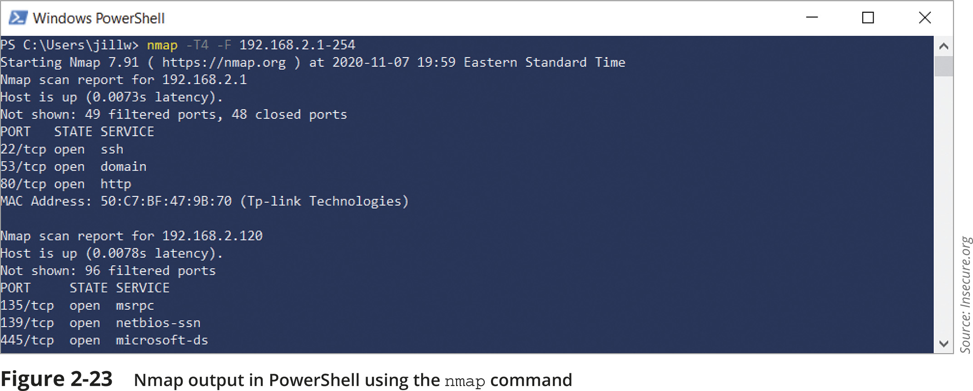
Network Diagrams (2 of 6)

Slide 4
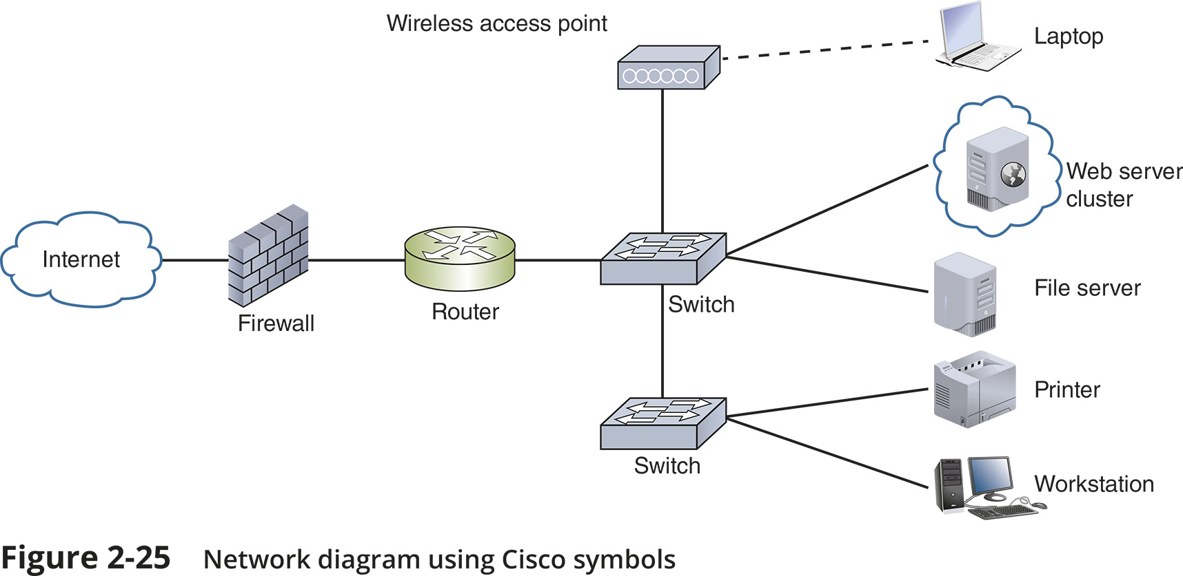
Network Diagrams (3 of 6)

Slide 5
Network Diagrams (4 of 6)
Network diagrams provide broad snapshots of a network’s physical or logical topology
Useful for planning where to insert a new switch or determining how a particular router, gateway, or firewall interact
Wiring schematic is a graphical representation of a network’s wired infrastructure
In detailed form, it shows every wire necessary to interconnect network devices
Rack diagram is a drawing that show devices stacked in a rack system

Slide 6
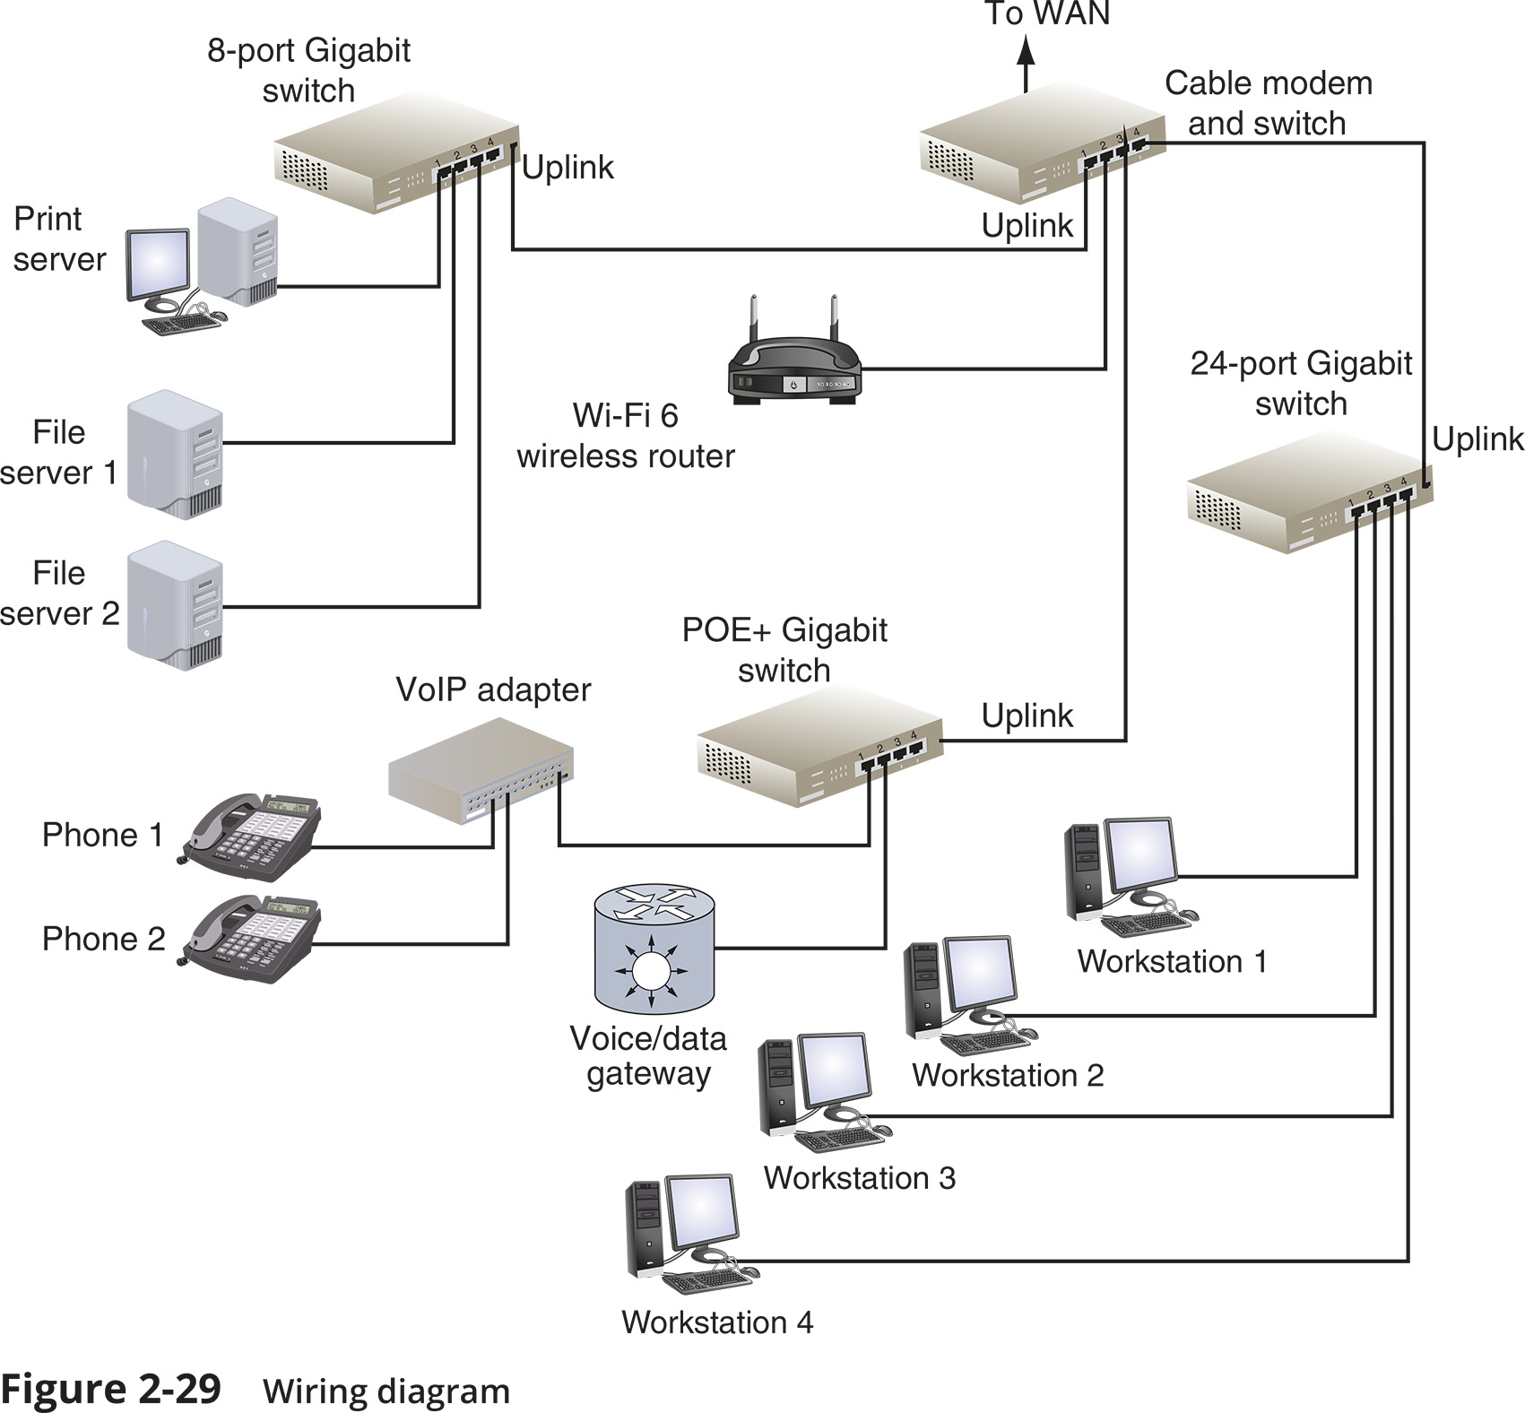
Network Diagrams (5 of 6)

Slide 7
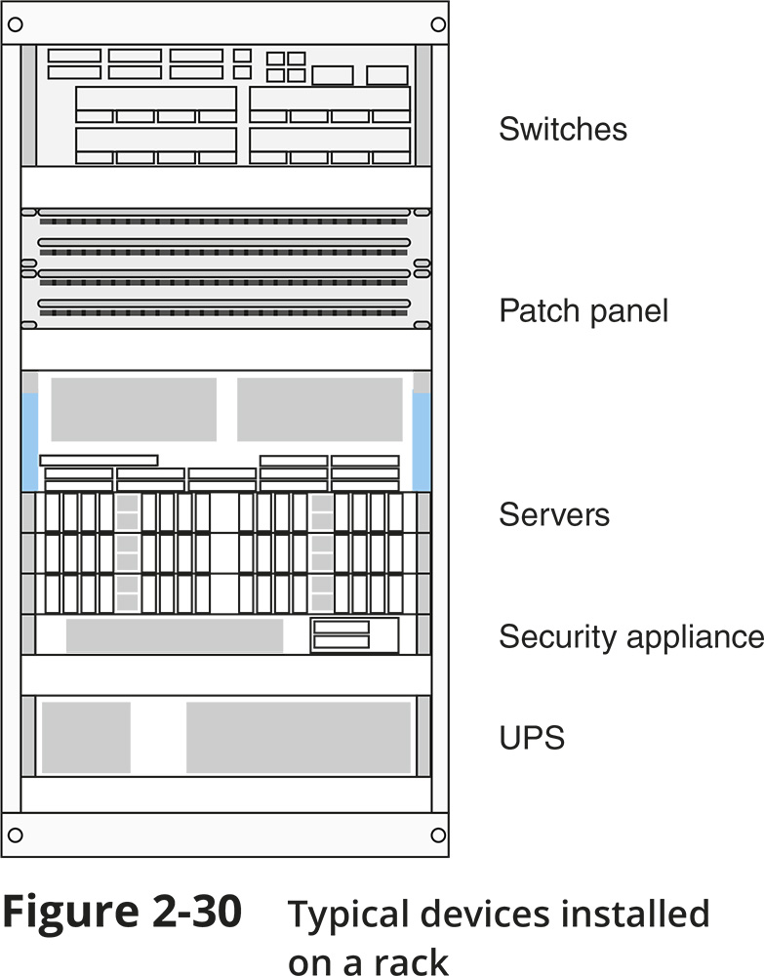
Network Diagrams (6 of 6)

Slide 8
Labelling and Naming Conventions (1 of 3)
Tips for labelling and naming conventions:
Use names that are as descriptive as possible
Only include fields that are essential in identifying the device
Don’t overcomplicate the name with useless or redundant information
Use established naming conventions
Think big-picture-down-to-details

Slide 9
Labelling and Naming Conventions (1 of 3)
Tips for labelling and naming conventions:
Consider any security risks from details included in your naming convention
Use colour-coded cables and use cable tags to identify each cable’s purpose
Label the ports and jacks that cables connect to
Where labels won’t fit on the device, draw a simple diagram of each device that indicates how each port is used
Use labels that are durable and are designed to stick to plastic and metal

Slide 10
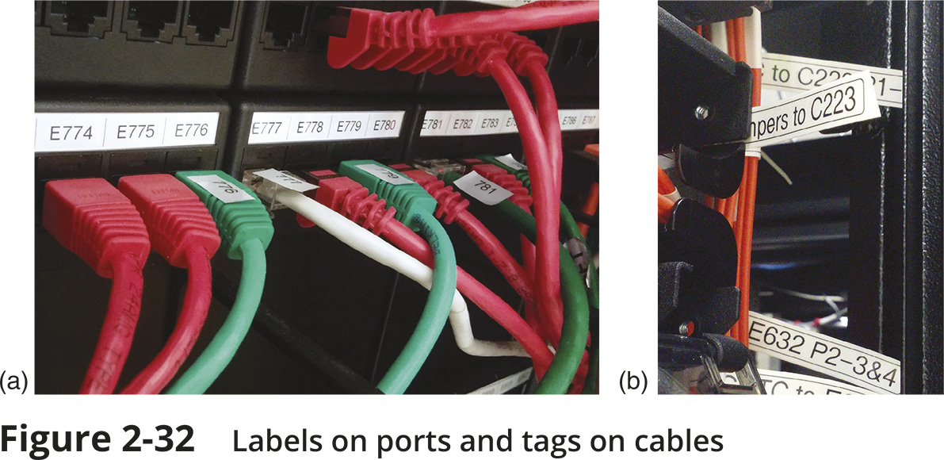
Labeling and Naming Conventions (2 of 3)

Slide 11
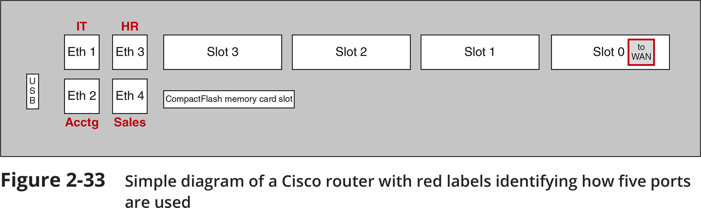
Labelling and Naming Conventions (3 of 3)

